Slide 1
Welcome to Technical Bootcamp: Day 4

Slide 2

A look into the Day 4 agenda
Day 4
8:00
Challenge Introduction
8:15
Begin POC Challenge
8:45
Please refer to the descriptions below for reference
9:00
Types of activities:
Attendees will participate in four different types of activities:
Break
10:00
Continue POC Challenge
11:00
Keynote
Labs
Break
11:15
Continue POC Challenge
Presentations
Challenges
Teams Cohort Activities
12:00
Lunch
Location of activities:
Each activity will take place in the following location:
13:00
Finish POC Challenge
13:30
14:00
Challenge Debrief
All-up Session: Teams bridge in calendar invite
Closing
Teams Cohort: “Meet Now” function in Teams Cohort Teams channel
15:00
Independent working time: No meeting, working in Spektra labs

Slide 3

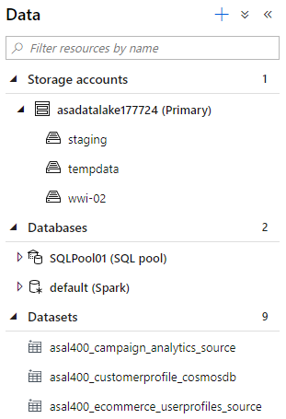
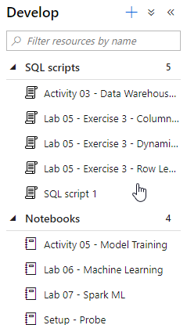

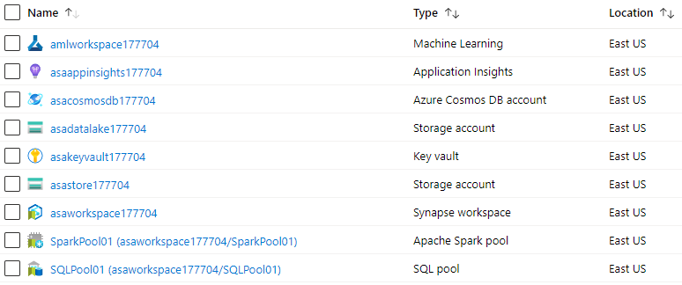

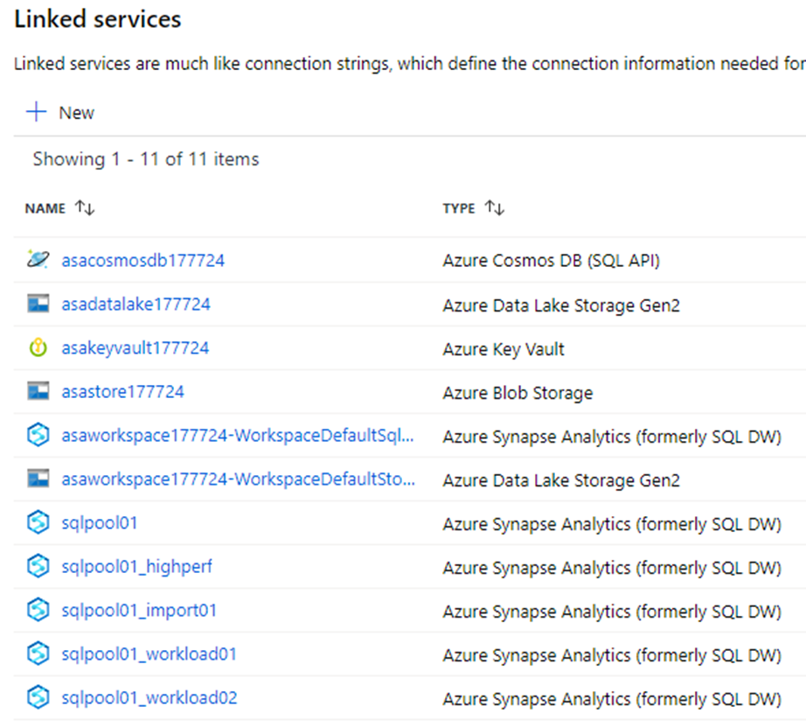
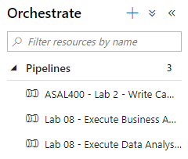
What you see
Data
Artifacts
9 Resources
1 SQL Pool
1 Cosmos DB
1 Data Lake
2 Pipelines
Resource Group: Synapse-L400-XXXXXX
Linked services
3 Datasets
15 Tables
722k Documents
100 GB
3 SQL Scripts
Pipelines
13 Users / Logins
30B Rows
3 Notebooks

Slide 4
What you didn’t see – a massive Synapse DevOps effort
We did that 160x
5 Hours setup / Environment
160+ Resource Groups
1 ARM Template
27 JSON
5 Azure Regions
20+ Staging Storage
6 PS Scripts
17 SQL Scripts
2 Clever Hacks

Slide 5
The Dataset
SalesGenerator
.NET Core 3.1
Parquet.NET ~30 hours to create on 20vcpu/160GB VM
MOADs (the Mother Of All Datasets from Solliance) ~30 Billion fact sale records
Baby MOADs
~3 Billion fact sale records
Mini MOADs
~985 Million fact sale records
Date, Product (5k), Store and Customer (10M) dimensions
All generated to have a realistic distribution of properties.
For example, product purchases have seasonality – all season, winter and summer

Slide 6
The Automation
ARM Template
Core Azure Resources
01-environment-setup
Idempotent execution
Assign Synapse Workspace Admins
Create Linked Services
Create Integration Runtime
Start SQL Pool
Scale up SQL Pool
Create SQL users, logins, roles
Create schemas and tables in SQL Pools
Create Data Sets
Create temp loading pipeline
Execute pipeline & cleanup
Scale down SQL Pool
Load Cosmos DB
02-environment-setup
Create Spark notebooks (using Livy)
Create SQL scripts
03-environment-validate
Check artifacts exist
Check tables and row counts
Check Cosmos DB doc count
04-environment-spark-test
Validate scale out (using Livy)
05-environment-fix
Apply artifact patches
06-environment-poc-01
Deploy challenge environment

Slide 7
Automation Demo

Slide 8






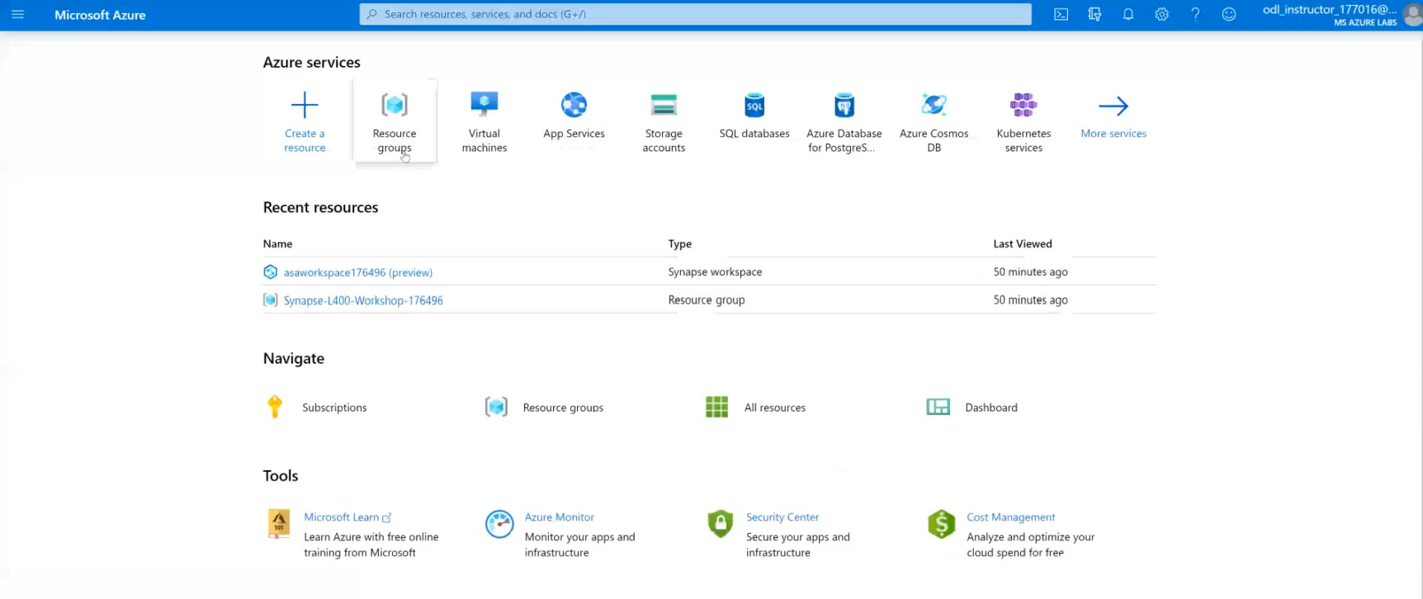

POC Challenge: group-based lab exercise
GUIDE:
PoC Challenge
https://github.com/solliancenet/data-ai-technical-bootcamp/
Step 1: Go to your table group channel
Step 2: You will use your cloud lab login for Azure
Step 3: Login to Azure. Engage your table group via a Microsoft Teams “meet now” call to collaborate with each other (meet now button in upper right corner of application)

Slide 9

What we covered and how to continue to learn
Thank you for participating
What was covered this week:
Together we learned how to develop performant Azure Synapse Analytics proof-of-concepts using the latest functionality for data ingestion, transformation, query optimization, security, monitoring, and machine learning.
How to keep learning:
Watch and learn with Microsoft Build
Explore Microsoft.com/learn for on-demand learning
Connect with us in our upcoming Architecture Design series (details coming in June)

Slide 10
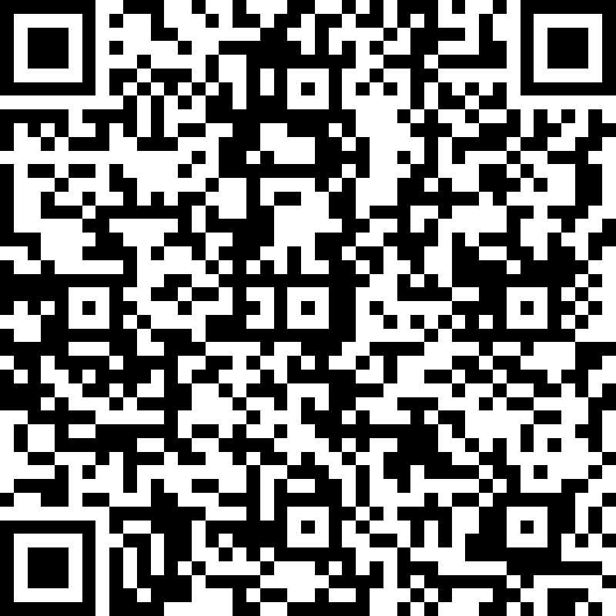
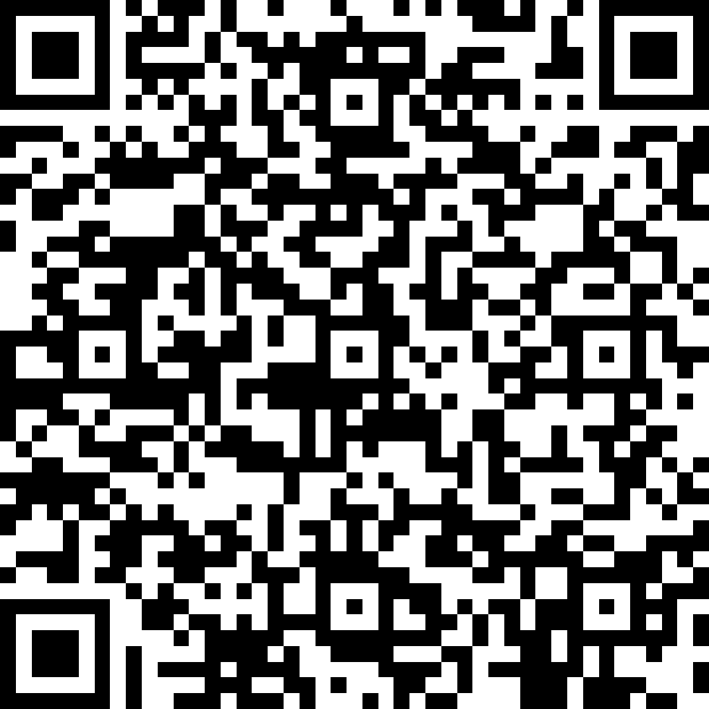
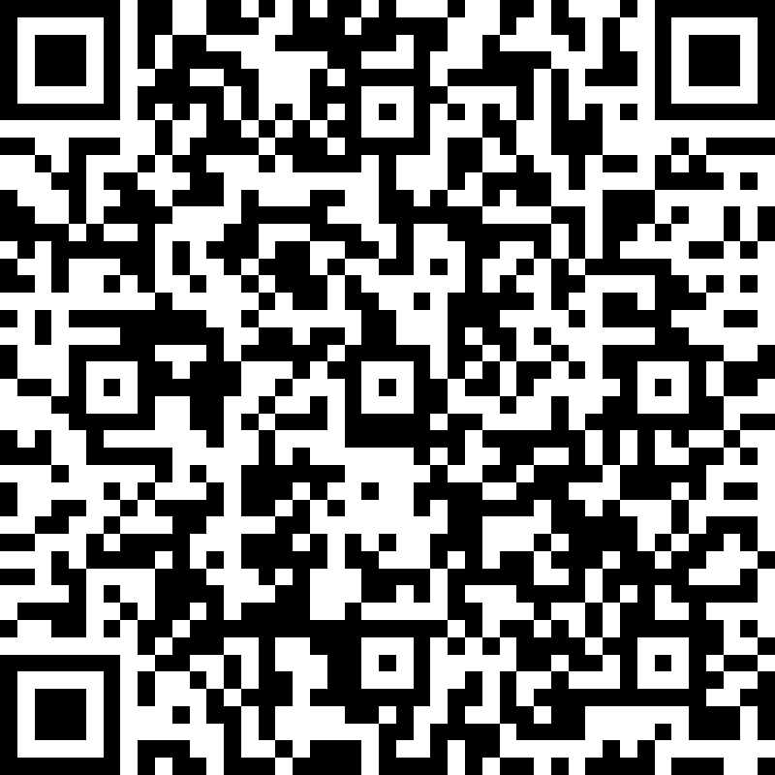
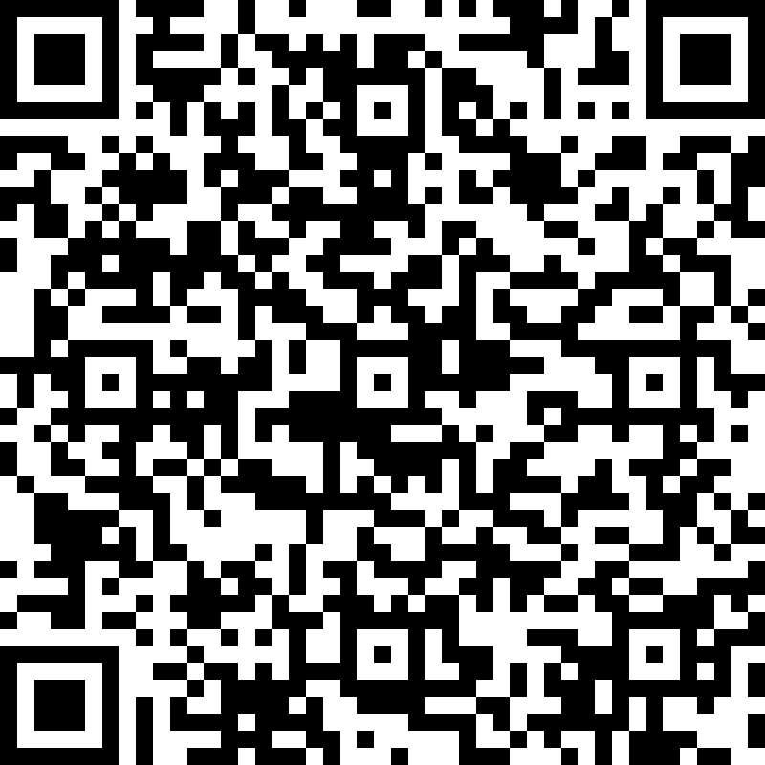
We’d love to hear from you!
Day 1 | Day 2 | Day 3 | Day 4
Scan the QR code below using your smartphone or access the link https://aka.ms/BCAmericasDay1 You’ll also receive a link to this survey by email. You only need to complete it once. Answer the survey questions to provide your feedback on Day 1 of Boot Camp. Be honest. Every bit of feedback helps us improve. | Scan the QR code below using your smartphone or access the link https://aka.ms/BCAmericasDay2 You’ll also receive a link to this survey by email. You only need to complete it once. Answer the survey questions to provide your feedback on Day 2 of Boot Camp. Be honest. Every bit of feedback helps us improve. | Scan the QR code below using your smartphone or access the link https://aka.ms/BCAmericasDay3 You’ll also receive a link to this survey by email. You only need to complete it once. Answer the survey questions to provide your feedback on Day 3 of Boot Camp. Be honest. Every bit of feedback helps us improve. | Scan the QR code below using your smartphone or access the link https://aka.ms/BCAmericasDay4 You’ll also receive a link to this survey by email. You only need to complete it once. Answer the survey questions to provide your feedback on Day 4 of Boot Camp. Be honest. Every bit of feedback helps us improve.

